Slide 1
Drilling and Hole Making Processes

Slide 2
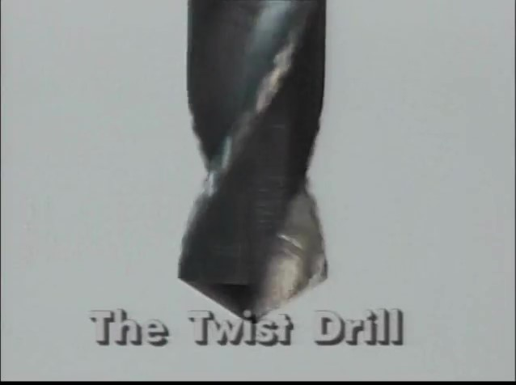
Watch Video Here
Notes:
Drill Parts

Slide 3
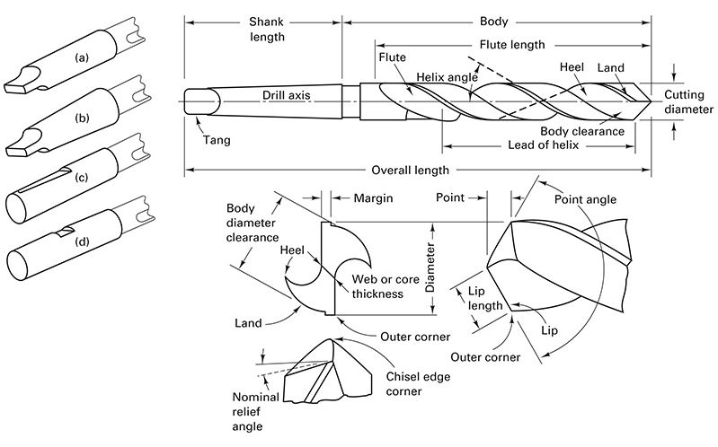
Nomenclature and Geometry of Conventional Twist Drill
Straight shank with tang
Tapered shank with tag
Straight shank with whistle notch
Straight shank with flat notch

Slide 4
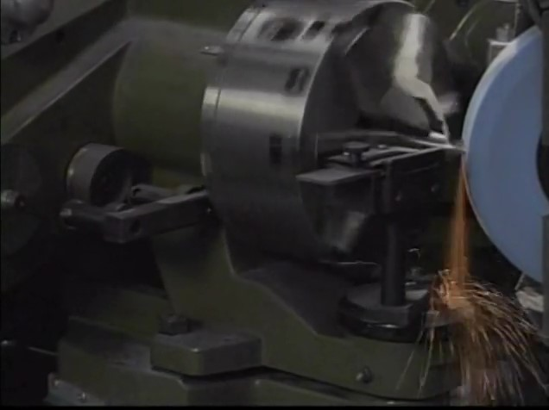
Watch Video Here
Notes:
Drill Sharpening

Slide 5
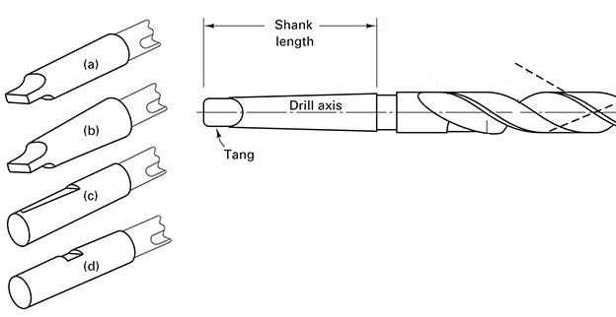
Shanks
Straight shank with tang
Tapered shank with tag
Straight shank with whistle notch
Straight shank with flat notch

Slide 6
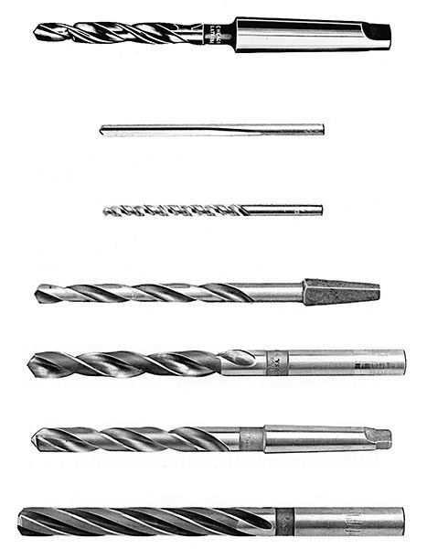
Shanks and Twist Drill Types
Taper Shank, Sub Land
Straight Shank, Straight Flute
Straight Shank High Helix
Bit Shank
Straight Shank
Taper Shank
Straight Shank, three flute

Slide 7
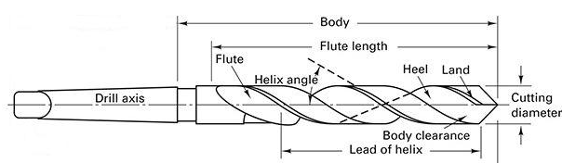
Drill Body

Slide 8
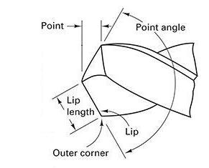
Point (Cone) Angle

Slide 9
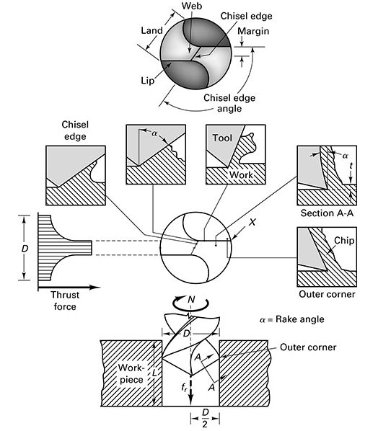
Drill Point

Slide 10
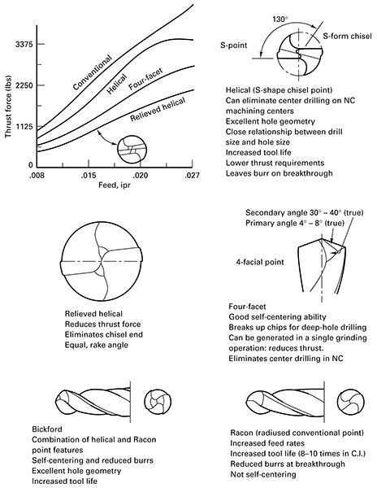
Drill Point Variations to Reduce Thrust

Slide 11
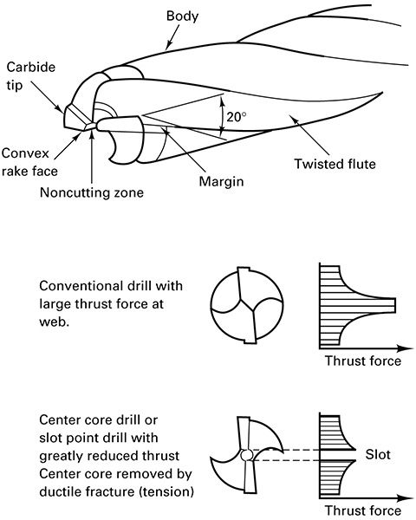
Low Thrust Drill Point

Slide 12
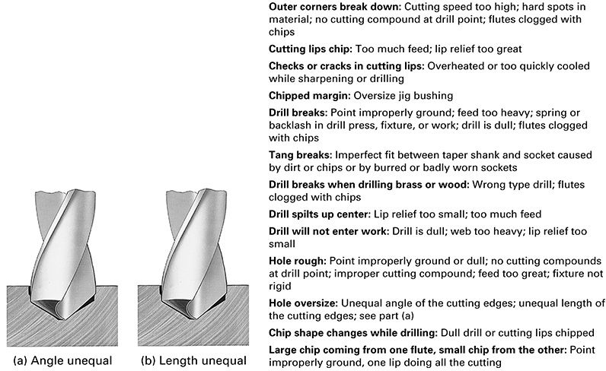
Improper Grinding

Slide 13
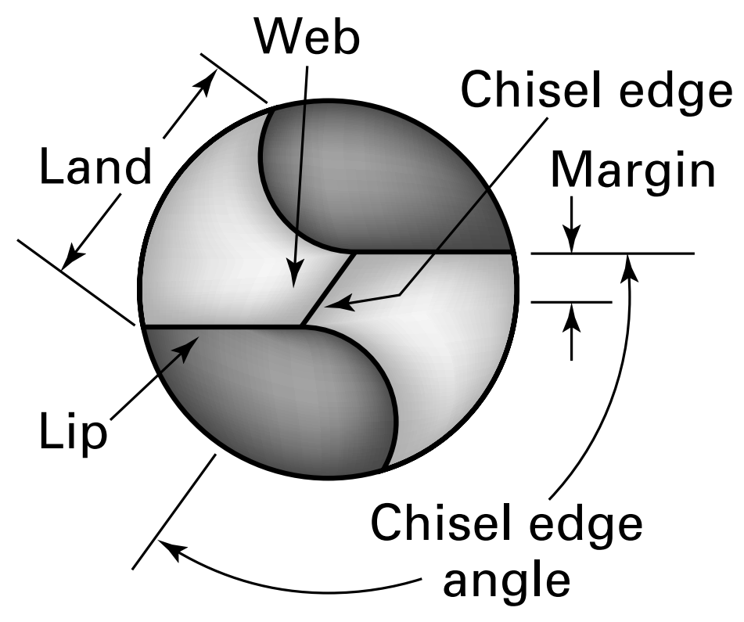
Chisel-Edge Angle

Slide 14
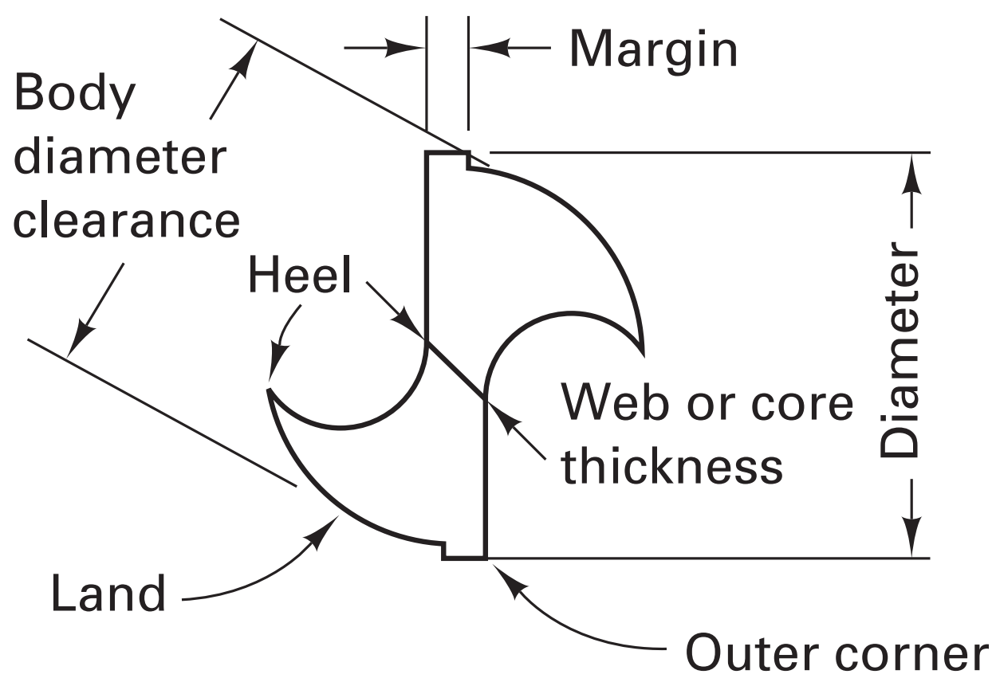
Web

Slide 15
Drill Sizes
Millimeter series
increments of 0.01 – 0.5mm in dia. from 0.015mm
Numerical series
No. 80 (0.0135”) to No. 1 (0.228”)
Letter sizes
A (0.234”) to Z (0.413”)
Fractional sizes
by 1/64” up to over 4 inches

Slide 16
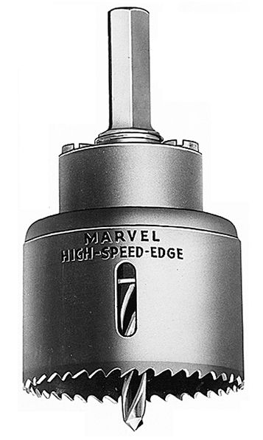
Hole Saw

Slide 17
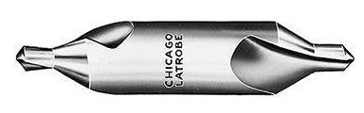
Center Drill

Slide 18
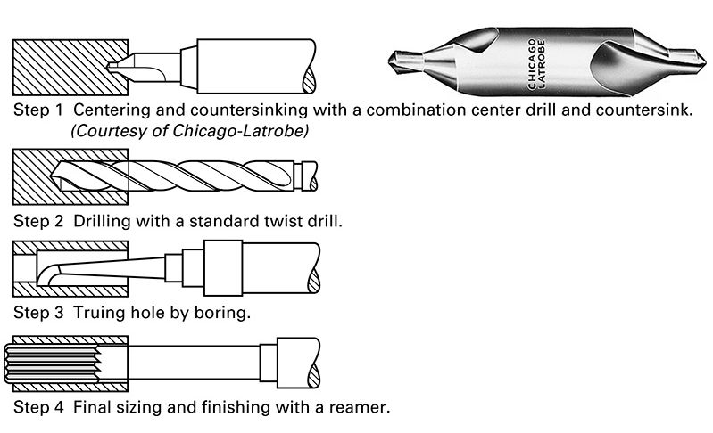
Four Steps to an Accurate Hole

Slide 19
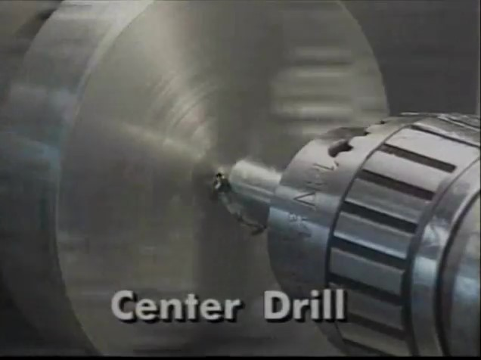
Watch Video Here
Notes:
Drill Types

Slide 20
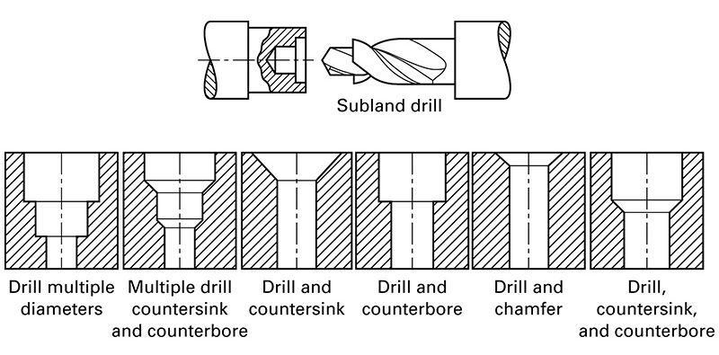
Combination Drills

Slide 21
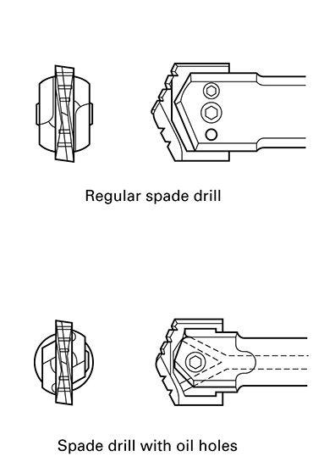
Spade Drill

Slide 22
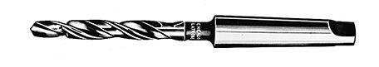
Morse Taper

Slide 23
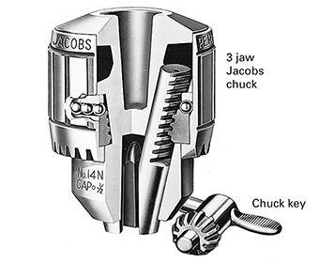
Universal (Jacobs) Chuck

Slide 24
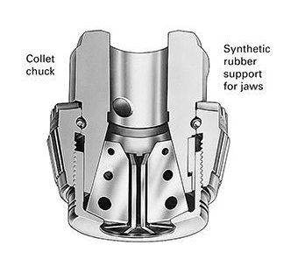
Collet Chuck

Slide 25
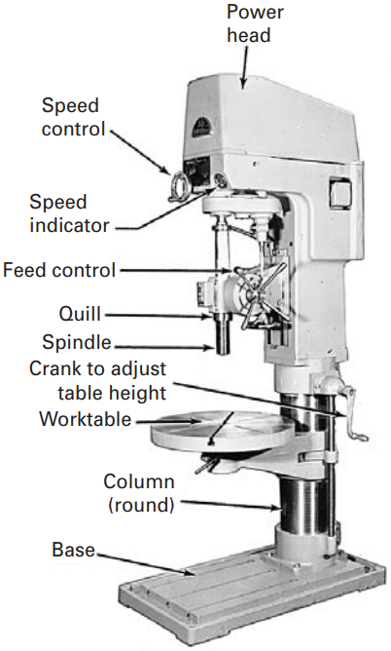
Upright Column Drilling Machine

Slide 26
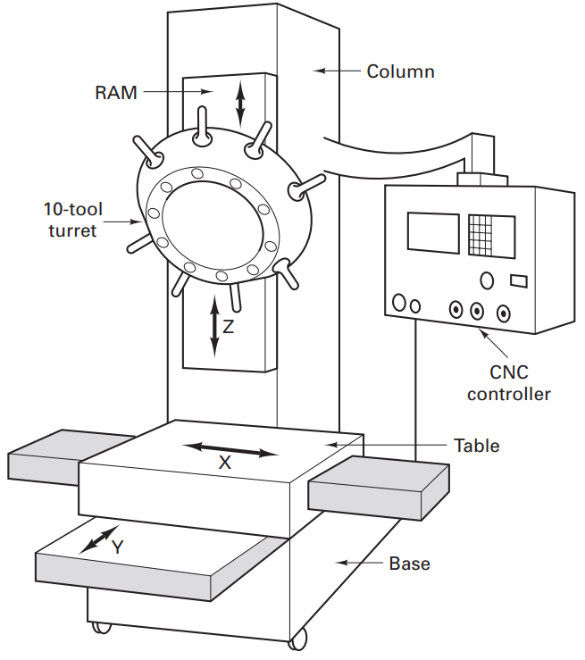
CNC Turret Drilling Machine

Slide 27
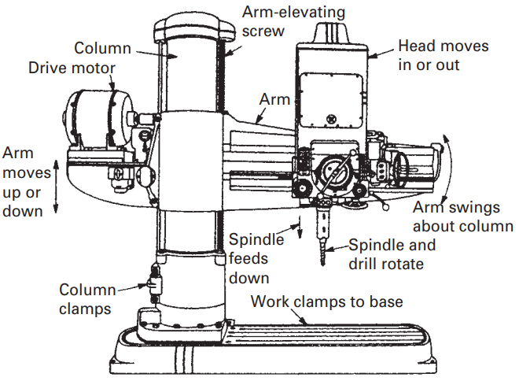
Radial Drill Press

Slide 28
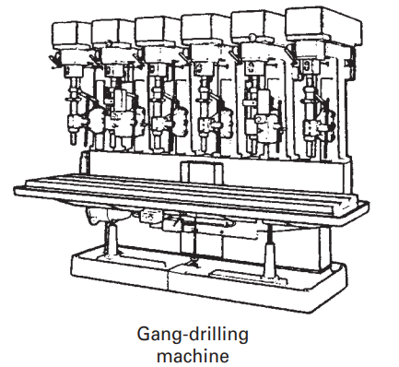
Gang Drilling Machine

Slide 29
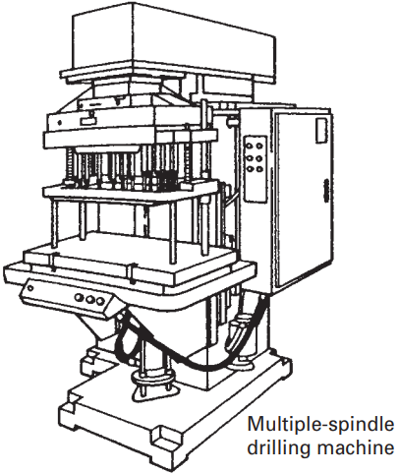
Multiple Spindle Drilling Machine

Slide 30
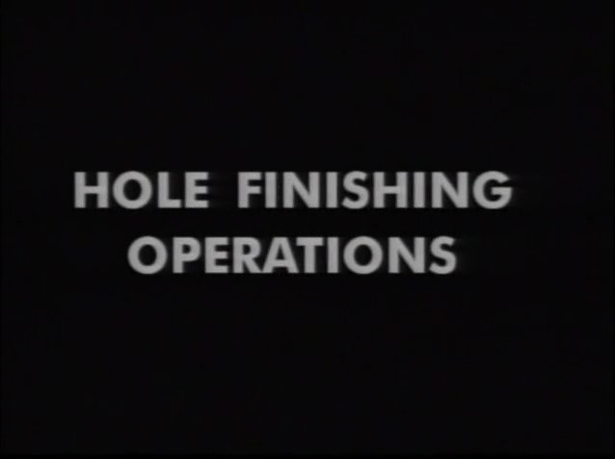
Watch Video Here
Notes:
Hole Finishing Operations

Slide 31
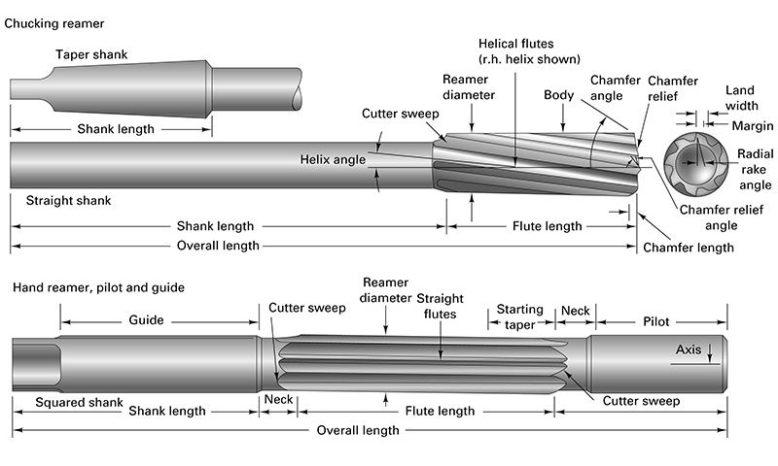
Reamer Nomenclature

Slide 32
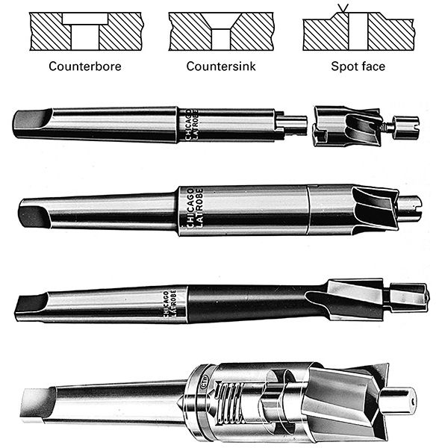
Counterbore, Countersink & Spot Face

